Slide 1


CS-446: Information Systems Security
Will not do chapter 8
Chapter # 9: Public Key Encryption
Prof. Dr. Sufian Hameed
Department of Computer Science
FAST-NUCES

Slide 2
Overview
What will you learn today
Public Key Encryption
Definition and Security
RSA Trapdoor
ISO Standard for RSA public key encryption

Slide 3
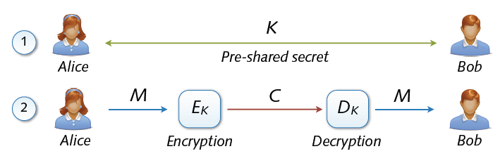
Key Exchange
Symmetric cryptosystems secure and efficient, but ...
Precondition: secure exchange of keys in advance
Paradox situation at a first glance
secure communication depends on secure key exchange

Slide 4
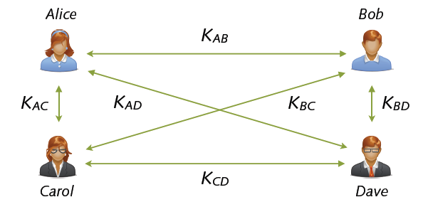
Multi-party Key Exchange
Involved multi-party key exchange with symmetric keys
Quadratic growths: n parties → (n2 - n) / 2 keys
Problem rooted in symmetry (shared keys). Alternatives?

Slide 5
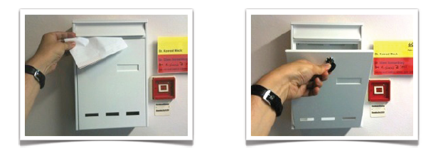
Asymmetric Keys
Solution: Two types of keys
public key pk (K+) = enables encryption but no decryption
Private/secret key sk (K–) = used for decryption only
Hard to deduce secret from public key
... similar to a classic mailbox

Slide 6
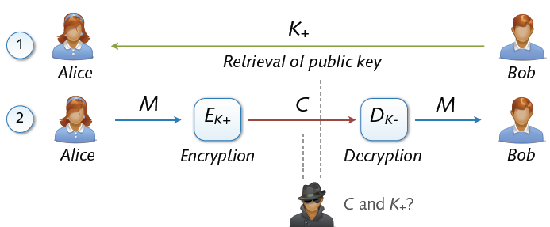
Asymmetric Cryptosystem
Asymmetric cryptosystems
Asymmetric encryption and decryption
K+ (pk) = public key of Bob K– (sk) = secret key of Bob
No secure key exchange necessary

Slide 7
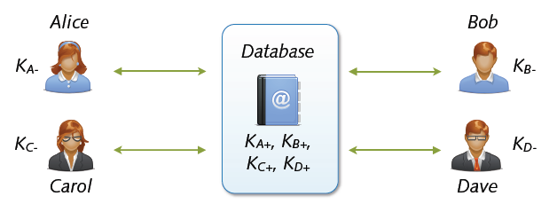
Key Exchange with Public Keys
Scalable communication with multiple parties
Linear number of exchanges: n parties → n public keys
Real-world systems with millions of keys (e.g. PGP)
... for the moment everything is fine

Slide 8
Applications
Session setup (for now, only eavesdropping security)
Non-interactive applications: (e.g. Email)
Bob sends email to Alice encrypted using pk_{alice}
Note: Bob needs pk_{alice} (public key management)
Alice
pk
Bob
Generate (pk, sk)
choose random x
(e.g. 48 bytes)
E(pk, x)
x

Slide 9
Security of several cryptosystems rests on different computational hard problems.
Many popular cryptographic schemes are based on the intractability of number theoretic problems such as factoring and discrete logarithms. These hard problems are widely believed to be intractable for classical algorithms.
What is computationally hard problem?
Computationally hard: a problem for which there is no proven algorithm for solving in a reasonable time. The larger the problem set, the harder it is to solve by any means

Slide 10
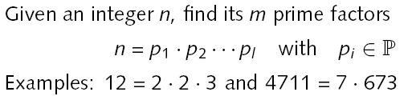
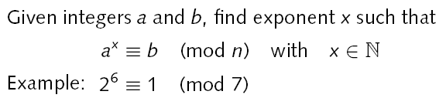
Hard Problems
Integer factorization
Discrete logarithm
Hardness: No polynomial-time algorithms known yet

Slide 11
For your reading and extra info:
Hardness assumptions on mathematical problems lie at the heart of modern cryptography; they are often what ensure one cannot break an encryption scheme
What are ‘hard problems’?
Some mathematical problems are harder than others, but what if some problems can never be solved? Well, this is exactly what much of modern cryptography relies on. Often it is assumed that a problem is hard, and this assumption is used to prove that it is impossible to break an encryption scheme, for example.
More formally, a hardness assumption on a particular problem is the assumption that there is no efficient algorithm (that runs in what we call polynomial time) that can solve it.
It is often not known whether there is a method to solve these hard problems efficiently, just that there is not currently a method to do so. However, most of the hard problems used in modern cryptography have been widely studied and so we can have confidence that the assumption they are hard is valid.
How are they used?
How can we use a hard problem in showing an encryption scheme is secure? We use what is called a reduction argument which runs as follows: we show that if an adversary can break the encryption scheme then they can also break the hard problem, thus ‘reducing’ the security to the hard problem.
Why does this work?
Why do these reductions work? Well, think about it this way:
We have made an assumption that a problem is hard and we have confidence that it is hard because these hard problems have been well studied.

Slide 12
We then take an adversary, who we assume can break our encryption scheme, and we show that this adversary (which we may have to adapt slightly — this is fine as long as it is still efficient or runs in polynomial time) can break the hard problem.
Although, now we have a contradiction as we assumed that no efficient adversary could solve the hard problem.
Thus, due to this contradiction, we know the adversary cannot break our encryption scheme or in other words, breaking the encryption scheme is as hard as solving the hard problem, which is hard, so we can be happy that it is hard to break the encryption scheme.
Let’s take a look at a couple of examples…
Factoring:
Factoring numbers is a hard problem. While it may seem very simple for low numbers, it is considered a hard problem for large numbers. The problem can be formulated as follows:
Take n = p.q where p and q are large prime numbers. The challenge, given the number n, is to find p and q.
DDH:
The second hardness assumption we will consider here is the decisional Diffie-Helman assumption. This assumption is based on cyclic groups, we saw these last week. Remember, that for cyclic group G we have a generator g (this is just an element that can be used to make every other element in the group).
The DDH assumption says that it is hard to distinguish between the following two tuples:
1. (ga,gb, g(a.b)) where a and b are chosen at random;
2. (ga,gb, gc) where a, b and c are chosen at random.
It is this hardness assumption that is used in the ElGamal encryption scheme.
https://medium.com/oxbridge-inspire/hard-problems-in-cryptography-cf0394cf8e79

Slide 13
A trapdoor function is a function that is easy to compute in one direction, yet difficult to compute in the opposite direction (finding its inverse) without special information, called the "trapdoor". Trapdoor functions are widely used in cryptography.

Slide 14
For your reading and extra info
A trapdoor function is a function that is easy to perform one way, but has a secret that is required to perform the inverse calculation efficiently. That is, if f is a trapdoor function, then y=f(x) is easy to compute, but x=f−1(y) is hard to compute without some special knowledge k. Given k, then it is easy to compute y=f−1(x,k). The Wikipedia article also contains a straight-forward explanation.
The analogy to a "trapdoor" is something like this: It's easy to fall through a trapdoor, but it's very hard to climb back out and get to where you started unless you have a ladder.
A hash function is not a trapdoor function because it is not reversible. Instead, it's called a one-way function. A one-way function is similar to a trapdoor function in that it's easy to compute both and it's very hard to reverse both, but there is no special key that allows you to reverse the one-way function.
Trapdoor functions as a subset of one-way functions: Trapdoors are a one-way function with the extra restriction that they have a secret for calculating the inverse.
For example: RSA is a one-way trapdoor function, but SHA-1 is just a one-way hash function. Discrete exponentiation is also (supposedly) just a one-way function, since there's no key information about the group that can be used to calculate the discrete logarithm efficiently.
That said, on a pragmatic note I have noticed that common Internet usage often mixes the terms "one-way" and "trapdoor" interchangeably, which no doubt causes confusion

Slide 15
Trapdoor One-way Functions
One-way function F(x) = y based on hard problem
Given input x: F(x) easy to compute
Given output y: hard to find input x with F(x) = y
Basis for asymmetry of public-key algorithms
Trapdoor one-way function F(x) = y
Given y and some secret: easy to find x with F(x) = y
Examples of secrets: prime factors, discrete logarithm
Basis for private key and decryption

Slide 16
Public Key Encryption
Def: a public-key encryption system is a triple of algs.(G, E, D)
G(): randomized alg. outputs a key pair (pk, sk)
E(pk, m): randomized alg. that takes m∈M and outputs c ∈C
D(sk,c): det. alg. that takes c∈C and outputs m∈M or ⊥
Consistency: ∀(pk, sk) output by G :
∀m∈M: D(sk, E(pk, m) ) = m
Notes:
In real life G actually takes security parameter like the size of the key

Slide 17
Trapdoor functions (TDF)
Def: a trapdoor func. X⟶Y is a triplet of efficient algs. (G, F, F⁻¹)
G(): randomized alg. outputs a key pair (pk, sk)
F(pk,⋅): det. alg. that defines a function X ⟶ Y
F⁻¹(sk,⋅): defines a function Y ⟶ X that inverts F(pk,⋅)
More precisely: ∀(pk, sk) output by G
∀x∈X: F⁻¹(sk, F(pk, x) ) = x
(G, F, F⁻¹) is secure if F(pk, ⋅) is a “one-way” function:
can be evaluated, but cannot be inverted without sk
Notes:
Deterministic Algorithm. an algorithm which, given a particular input, will always produce the same output, with the underlying machine always passing through the same sequence of states.

Slide 18
Explanation of slide 17
So what is a trapdoor function?
Well, a trapdoor function basically is a function that goes from some set X to some
set Y. And it's really defined by a triple of algorithms.
There's a generation algorithm G, the function F, and the inverse of the function F⁻¹.
So the generation Algorithm G, basically what it does when you run it, it will generate a key pair, a public key and a secret key.
The public key is gonna define a specific function F from the set X to the set Y.
And then the secret key is going to define the inverse Function F⁻¹ now from the set Y to the set X.
So the idea is that you can evaluate the function at any point using a public key PK and then you can invert that function using the secret key, SK.
So what do I mean by inversion? More precisely, if we look at any public key and secret key pair generated by the key generation algorithm G, then it so happens that if I evaluate the function at the point X, and then I evaluate the inverse at the resulting point, I should get the original point X back.

Slide 19
So the picture you should have in your mind, is there is this big set X and this big set Y And then, this function will map any point in X to a point in Y, and this can be done using the public key.
So again any point in X can be mapped, to a point in Y.
And then if someone has the secret key, then basically they can go in the reverse direction by applying, this secret key sk
X
Y

Slide 20
Explanation of slide after this slide 21
So using the concept of a trapdoor function, it's not too difficult to build a public key encryption system, and let me show you how to do it.
So here we have we our trap door function, (G, F, and F inverse). The other
tool that we are going to need is a symmetric encryption scheme, and I'm going to
assume that this encryption scheme is actually secure against active attacks, so in
particular I needed to provide authenticated encryption.
Notice that the symmetric encryption system takes keys in K and the trapdoor function takes inputs in X.
Those are two different sets and so we're also gonna need the hash function.
That goes from X to K. In other words, it maps elements in the set X into keys for
the symmetric encryption systems. And now once we have these three components, we can actually construct the public key encryption system as follows: so the key
generation for the public key encryption system is basically exactly the same as
the key generation for the trap door function. So we run G for the trap door
function, we get a public key and a secret key.
And those are gonna be the public and secret keys for the public key encryption system.

Slide 21
Public-key encryption from TDFs
(G, F, F⁻¹): secure TDF X ⟶ Y
(E_{s}, D_{s}) : symmetric auth. encryption defined over (K,M,C)
H: X ⟶ K a hash function
We construct a pub-key enc. system (G, E, D):
Key generation G: same as G for TDF

Slide 22
Public-key encryption from TDFs
(G, F, F⁻¹): secure TDF X ⟶ Y
(E_{s}, D_{s}) : symmetric auth. encryption defined over (K,M,C)
H: X ⟶ K a hash function
E( pk, m) :
x ⟵ X, y ⟵ F(pk, x)
k ⟵ H(x), c ⟵ E_{s}(k, m)
output (y, c)
D( sk, (y,c) ) :
x ⟵ F⁻¹(sk, y),
k ⟵ H(x), m ⟵ D_{s}(k, c)
output m
R

Slide 23
And how do we encrypt and decrypt?
Let's start with encryption.
So the encryption algorithm takes a public key and a message as input.
So what it will do is it will generate a random X from the set capital X. It will then apply the trapdoor function to this random X, to obtain Y.
So Y is the image of X under the trapdoor function.
Then it will go ahead and generate a symmetric key by hashing X.
So this is a symmetric key for the symmetric key system. And then finally it encrypts the plain text message 'm' using this key that was just generated. And then it outputs the value Y that it just computed, which is
the image of X, along the encryption under the symmetric system of the message M. So that's how encryption works. And I want to emphasize again that the trapdoor function is only applied to this random value X, whereas the message itself is encrypted using a symmetric key system using a key that was derived from the value X that we chose at random.
E( pk, m) :
x ⟵ X, y ⟵ F(pk, x)
k ⟵ H(x), c ⟵ E_{s}(k, m)
output (y, c)

Slide 24
So now that we understand encryption, let's see how to decrypt.
D( sk, (y,c) ) :
x ⟵ F⁻¹(sk, y),
k ⟵ H(x), m ⟵ D_{s}(k, c)
output m
While the decryption algorithm takes a secret key as input, and the ciphertext.
The ciphertext itself contains two components, the value Y and the value C.
So the first step we're gonna do, is we're gonna apply the inverse transformation,
the inverse trap door function to the value Y, and that will give us back the
original X that was chosen during encryption. So now let me ask you, how do
we derive the symmetric decryption key K from this X that we just obtained? Well,
so that's an easy question. We basically hash X again. That gives us K just as
during encryption. And now that we have this symmetric encryption key we can apply
the, the symmetric decryption algorithm to decrypt the ciphertext C. We get the
original message M and that's what we output. So, that's how the public key
encryption system works were this trap door function is only used for encrypting
some sort of a random value X and the actual message is encrypted using the
symmetric system

Slide 25
Public-key encryption from TDFs
(G, F, F⁻¹): secure TDF X ⟶ Y
(E_{s}, D_{s}) : symmetric auth. encryption defined over (K,M,C)
H: X ⟶ K a hash function
E( pk, m) :
x ⟵ X, y ⟵ F(pk, x)
k ⟵ H(x), c ⟵ E_{s}(k, m)
output (y, c)
D( sk, (y,c) ) :
x ⟵ F⁻¹(sk, y),
k ⟵ H(x), m ⟵ D_{s}(k, c)
output m
R

Slide 26
So in pictures here, we have the message M obviously the plain
text could be quite large. So, here we have the body of the deciphered text which
can be quite long is actually encrypted using the symmetric system. And then again
I emphasize that the key for the symmetric system is simply the hash of X.
And then the header of ciphertext is simply this application of the trapdoor
function to this random X that we picked. And so during decryption what happens is
we first decrypt the header to get X and then we decrypt the body using the
symmetric system to actually get the original plain text M. So as usual when I
show you a system like this, obviously you want to verify that decryption in fact is
the inverse of encryption. But more importantly you want to ask why is this
system secure. And in fact there's a nice security theorem here that says. That if
the trap door function that we started with is secure. In other words, that's a
one way function if the adversary doesn't have a secret key. The symmetric
encryption system provides authenticated encryption. And the hash function is a
random oracle, which simply means that it's a random function from the set X to
the set of keys K. So a random oracle is some sort of an idealization of, what a
hash function is supposed to be.

Slide 27
In practice, of course, when you come to
implement a system like this, you would just use, SHA-256, or any of the
other hash functions that we discussed in class. So, under those three conditions in
fact the system that we just described is chosen cipher text secure so it is CCA
secure, the little ro here just denote the fact that security is set in whats called
a random oracle model. But, that's a detail that's actually not so important for
discussion here, what I want you to remember is that if the trap door function
is in fact a secure trap door function. The symmetric encryption system is secure
against tampering so it provides authenticated encryption. And H
is in some sense a good hash function. It's a random, function, which in practice
you would just use SHA-256, then in fact the system that we just showed is CCA
secure, is chosen ciphertext secure. I should tell you that there's actually an ISO
standard that, defines this mode of encryption, of public encryption. ISO
stands for International Standards Organization. So in fact this particular
system has actually been standardized, and this is a fine thing to use. I'll refer to
this as the ISO encryption in the next few segments.

Slide 28
In pictures:
Security Theorem:
If (G, F, F⁻¹) is a secure TDF, (E_{s}, D_{s}) provides auth. enc. and H: X ⟶ K is a “random oracle” then (G,E,D) is CCA^{ro} secure.
F(pk, x)
E_{s}( H(x), m )
header
body
Notes:
Need to explain what is a random oracle. NEVER encrypt m directly with RSA.

Slide 29
To conclude this segment, I want
to warn you about an incorrect way of using a trapdoor function to build a
public key encryption system. And in fact this method might be the first thing that
comes to mind, and yet it's completely insecure. So let me show you, how not to
encrypt using a trapdoor function. Well the first thing that might come to mind
is, well, let's apply the trapdoor function directly to the message M. So we
encrypt simply by applying a function to the message M, and we decrypt simply by
applying F inverse to the ciphertext C to recover the original message M. So
functionally, this is in fact, decryption is the inverse of encryption, and yet this
is completely insecure for many, many different reasons. The easiest way to see
that this is insecure, is that it's simply, this is deterministic encryption.
You notice there is no randomness being used here. When we encrypt a message
M, and since it is deterministic, it's cannot possibly be
semantically secure.

Slide 30
But in fact, as I said, when we instantiate this trap door
function with particular implementations, for example with the RSA trap door
function, then there are many, many attacks that are possible on this
particular construction, and so you should never, ever, ever use it, and I'm gonna
repeat this throughout this module, and in fact in the next segment I'll show you a
number of attacks on this particular implementation. Okay so, what I would like
you to remember is that you should be using an encryption system like the ISO
standard, and you should never apply the trap door function directly to the message M.
Although in the next segment we'll see other ways to encrypt using a trap
door function that are also correct, but this particular method is clearly, clearly
incorrect. Okay, so now that we understand how to build public key encryption
given a trap door function, the next question is how to construct trap door
functions

Slide 31
Incorrect use of a Trapdoor Function (TDF)
Never encrypt by applying F directly to plaintext:
Problems:
Deterministic: cannot be semantically secure !!
Many attacks exist
E( pk, m) :
output c ⟵ F(pk, m)
D( sk, c ) :
output F⁻¹(sk, c)

Slide 32
In the previous Slides we saw how to build public key encryption from trapdoor
functions, in this segment we're going to build a classic trapdoor function called RSA

Slide 33
The RSA trapdoor permutation
First published: Scientific American, Aug. 1977.
Very widely used:
SSL/TLS: certificates and key-exchange
Secure e-mail and file systems
… many others

Slide 34
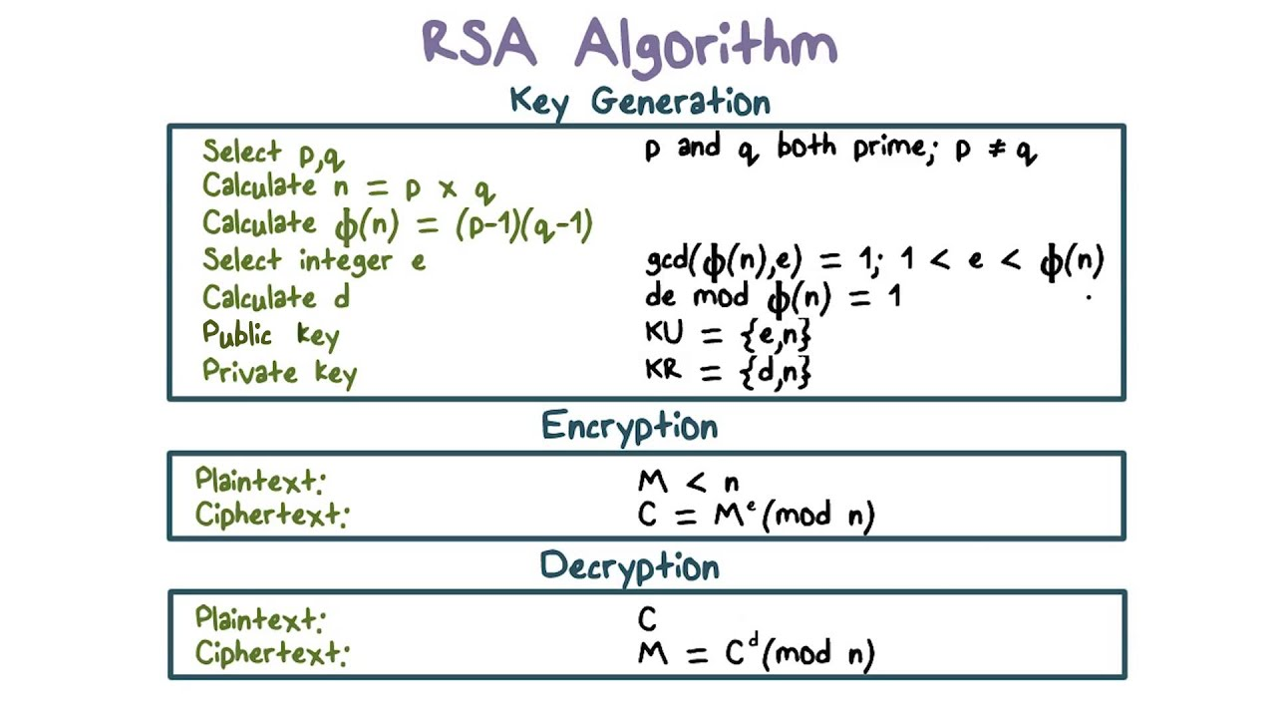

Slide 35
The RSA Algorithm Example
Choose p = 3 and q = 11
Compute n = p * q = 3 * 11 = 33
Compute φ(n) = (p - 1) * (q - 1) = 2 * 10 = 20
Choose e such that 1 < e < φ(n). Let e = 7
Compute a value for d such that (d * e) % φ(n) = 1. One solution is d = 3 [(3 * 7) % 20 = 1]
Public key is (e, n) => (7, 33)
Private key is (d, n) => (3, 33)
The encryption of m = 2 is c = 2⁷ % 33 = 29
The decryption of c = 29 is m = 29³ % 33 = 2

Slide 36
The RSA trapdoor permutation
Choose random primes p, q (≈1024 bits) and compute N = p.q
Compute Euler function ϕ(N) = (p-1)(q-1)
Choose random encryption key e with gcd (e, ϕ(N)) = 1
Compute decryption key d = e⁻¹ mod ϕ(N)
s.t. e⋅d = 1 (mod ϕ(N) )
output pk = (N, e) , sk = (N, d)
F( pk, x ): RSA(x) = x^{e} (in Z_{N}) = y
F⁻¹( sk, y) = y^{d} ; y^{d} = RSA(x)^{d} = x^{ed} = x^{kϕ(N)+1} = (x^{ϕ(N)})^{k} ⋅ x = x

Slide 37


Security of RSA
Main attack vectors against RSA
Decrypting ciphertext c directly:
→ Difficulty of computing roots in modular arithmetic
Deriving private key
→ Difficulty of computing prime factors from n
Security (difficulty) depends on size of prime numbers
Factorization of numbers up to 768 bits feasible
Keys with 2048 and more bits deemed secure
(that is, ~600 decimal digits)

Slide 38
Textbook RSA is insecure
Textbook RSA encryption:
public key: (N,e) Encrypt: c ⟵ m^{e} (in Z_{N})
secret key: (N,d) Decrypt: c^{d} ⟶ m
Insecure cryptosystem !!
Is not semantically secure and many attacks exist
⇒ The RSA trapdoor permutation is not an encryption scheme !

Slide 39
Key lengths
Security of public key system should be comparable to security of symmetric cipher:
RSA
Cipher key-size Modulus size
80 bits 1024 bits
128 bits 3072 bits
256 bits (AES) 15360 bits

Slide 40
Implementation attacks
Timing attack: [Kocher et al. 1997] , [BB’04] The time it takes to compute c^{d} (mod N) can expose d
Power attack: [Kocher et al. 1999) The power consumption of a smartcard while it is computing c^{d} (mod N) can expose d.
Faults attack: [BDL’97] A computer error during c^{d} (mod N) can expose d.
A common defense:: check output. 10% slowdown.
Notes:
BB’04: Boneh-Brumley

Slide 41
Key Exchange with Public Key Encryption

Slide 42
Public key encryption
Alice
Bob
E
D
Notes:
Picture of cipher

Slide 43
Public key encryption
Def: a public-key encryption system is a triple of algs. (G, E, D)
G(): randomized alg. outputs a key pair (pk, sk)
E(pk, m): randomized alg. that takes m∈M and outputs c ∈C
D(sk,c): det. alg. that takes c∈C and outputs m∈M or ⊥
Consistency: ∀(pk, sk) output by G :
∀m∈M: D(sk, E(pk, m) ) = m

Slide 44
Establishing a shared secret
Alice
Bob
(pk, sk) ⟵ G()
“Alice”, pk
choose random
x ∈ {0,1}¹²⁸

Slide 45
Security (eavesdropping)
Adversary sees pk, E(pk, x) and wants x ∈M
Semantic security ⇒
adversary cannot distinguish
{ pk, E(pk, x), x } from { pk, E(pk, x), rand∈M }
⇒ can derive session key from x.
Note: protocol is vulnerable to man-in-the-middle

Slide 46
Insecure against man in the middle
As described, the protocol is insecure against active attacks
Alice
MiTM
Bob
(pk, sk) ⟵ G()
(pk’, sk’) ⟵ G()
“Alice”, pk
choose random
x ∈ {0,1}¹²⁸
“Bob”, E(pk, x)
“Bob”, E(pk’, x)

Slide 47
Public key encryption: constructions
Constructions generally rely on hard problems from number theory and algebra
Next module:
Brief detour to catch up on the relevant background

Slide 48
Acknowledgements
Material in this lecture are taken from the slides prepared by:
Prof. Dan Boneh (Standford)
Prof. Dr. Konrad Rieck (Uni-Göttingen)
Edited by
Abdullah Bin Zarshaid

